Slide 1
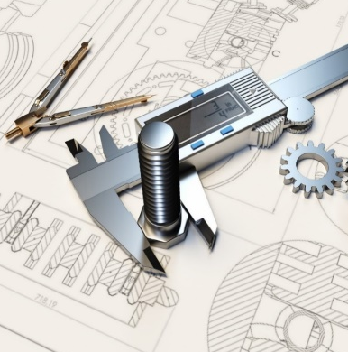
REPORT: Engineering DESIGN Internship – Phase I [1/12]
TITLE → <Convert existing Turbocharger to 3D Digital Twin>
Problem Statement
Objective
To convert existing Turbocharger into a 3D digital twin.
To create 3D digital twin of turbocharger.
To identify the components and its working.
To understand design and geometry of turbocharger.
College/ Institute/ University Name: _________________________________
Professor: _________________________________________
Prepared by : Aman Kumar
USN:1DS21ME010
College/ Institute/ University Name – Dayananda Sagar College Of Engineering

Slide 2

REPORT: Engineering DESIGN Internship – Phase I [2/12]
TITLE → <Convert existing Turbocharger to 3D Digital Twin>
Methodology
Analyzing the Architecture of equipment/ device/ machine/ assembly
Each and every component of turbocharger have been analyzed and has been found that it consists of :
Compressor Wheel
Compressor Cover
Exhaust Turbine Wheel with shaft
Exhaust Housing
Gasket
Exhaust Clamp Ring
Bearing Housing
College/ Institute/ University Name: _________________________________
Professor: _________________________________________
College/ Institute/ University Name – Dayananda Sagar College Of Engineering

Slide 3
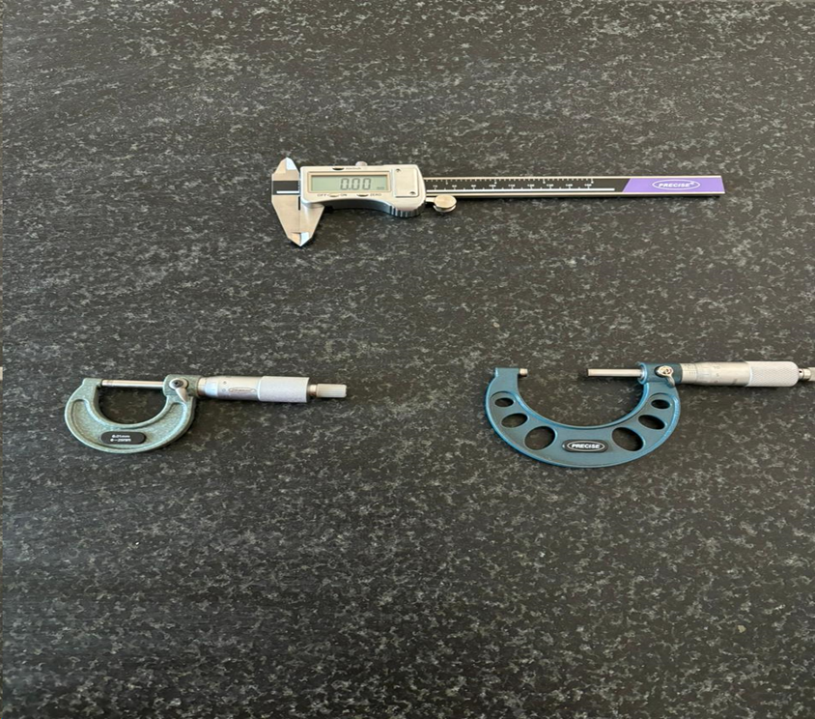
REPORT: Engineering DESIGN Internship – Phase I [3/12]
TITLE → <Convert existing Turbocharger to 3D Digital Twin>
MEASURING DIMENSIONS
Vernier Calliper has been used for measuring linear dimensions of the parts of turbocharger.
Micrometer and screw gauge has been used to measure the thickness of blades of compressor wheel and turbine.
The concept of reverse engineering has been applied .
College/ Institute/ University Name: _________________________________
Professor: _________________________________________
College/ Institute/ University Name – Dayananda Sagar College Of Engineering

Slide 4
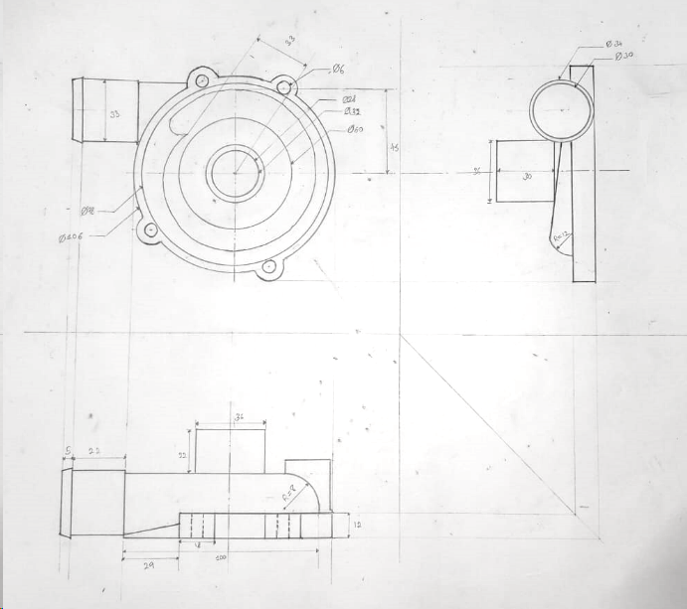
REPORT: Engineering DESIGN Internship – Phase I [4/12]
TITLE → <Convert existing Turbocharger to 3D Digital Twin>
ENGINEERING SCHEMATIC SKETCH
College/ Institute/ University Name: _________________________________
Professor: _________________________________________
Compressor Cover
College/ Institute/ University Name – Dayananda Sagar College Of Engineering

Slide 5
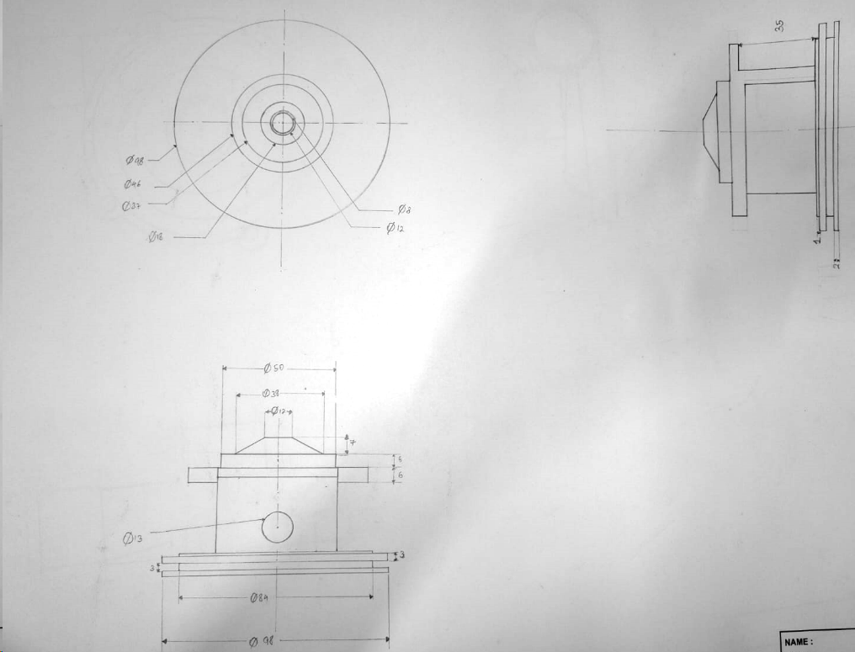
REPORT: Engineering DESIGN Internship – Phase I [5/12]
TITLE → <Convert existing Turbocharger to 3D Digital Twin>
ENGINEERING SCHEMATIC SKETCH
College/ Institute/ University Name: _________________________________
Professor: _________________________________________
Bearing Housing
College/ Institute/ University Name – Dayananda Sagar College Of Engineering

Slide 6
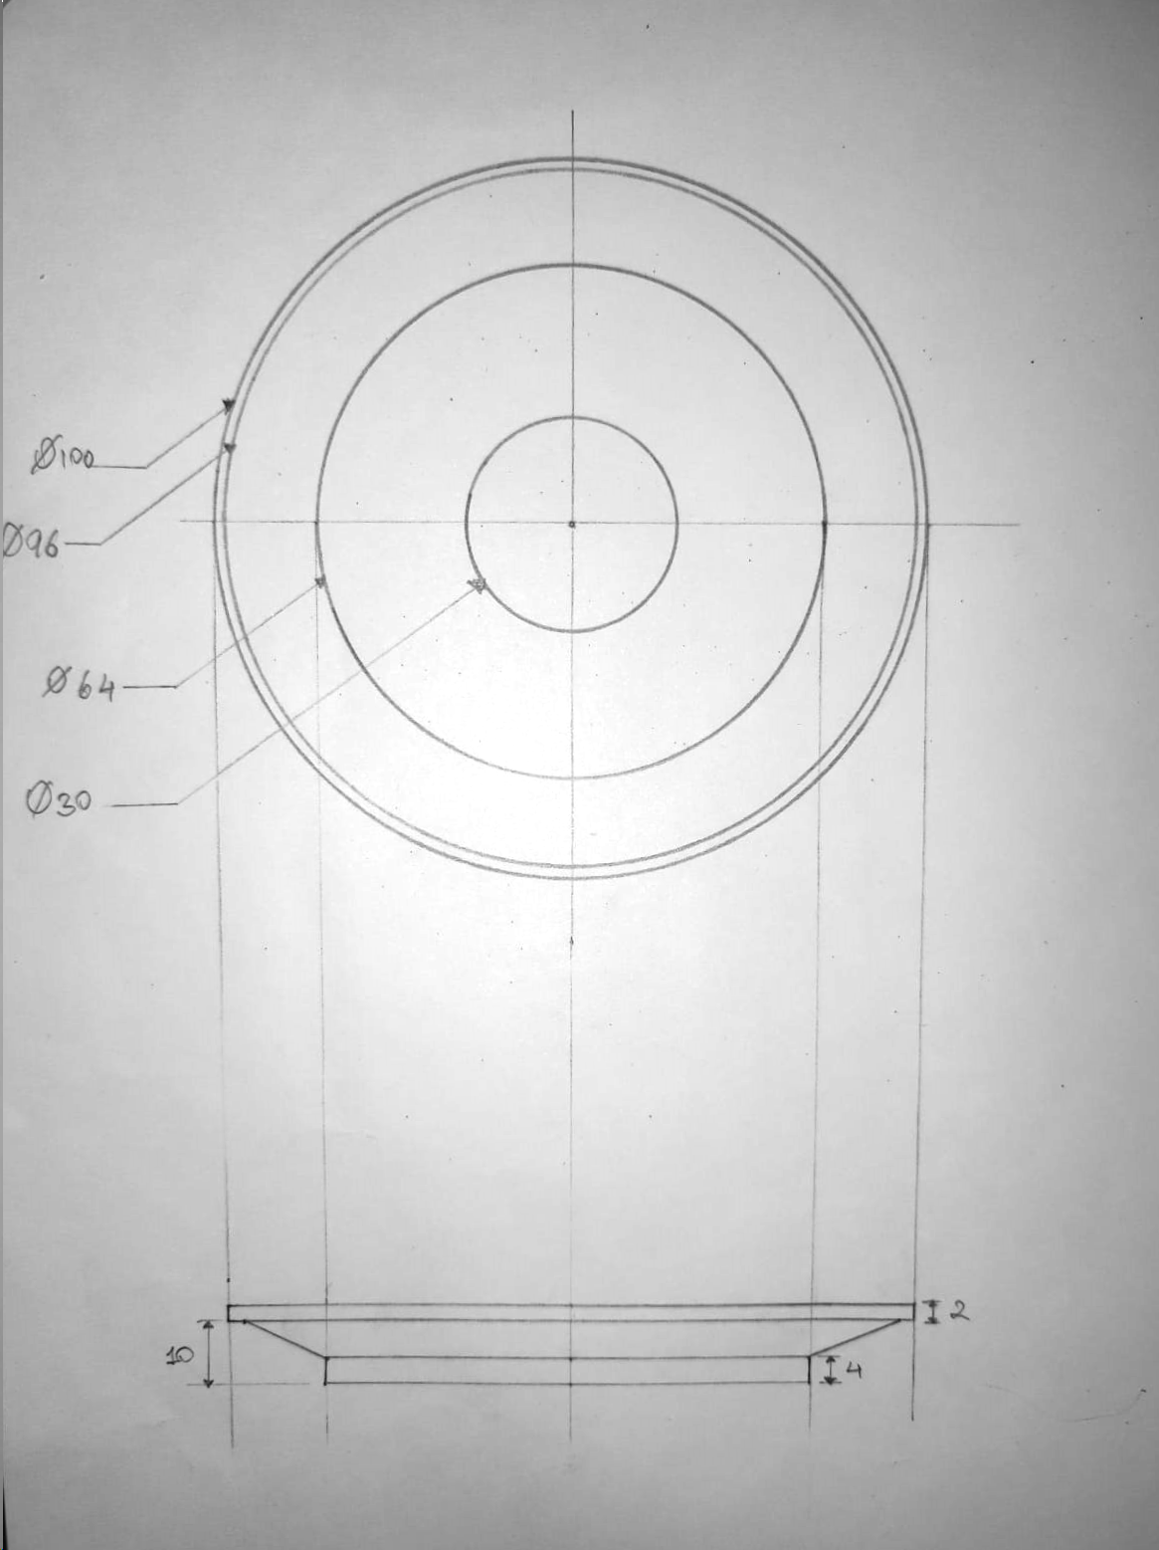
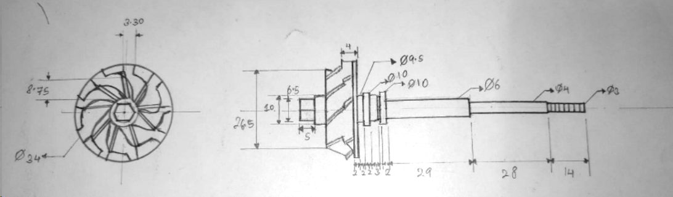
REPORT: Engineering DESIGN Internship – Phase I [6/12]
TITLE → <Convert existing Turbocharger to 3D Digital Twin>
ENGINEERING SCHEMATIC SKETCH
Exhaust Clamp Ring [Scale(2:1)]
College/ Institute/ University Name: _________________________________
Professor: _________________________________________
Exhaust Turbine Wheel with Shaft
College/ Institute/ University Name – Dayananda Sagar College Of Engineering

Slide 7
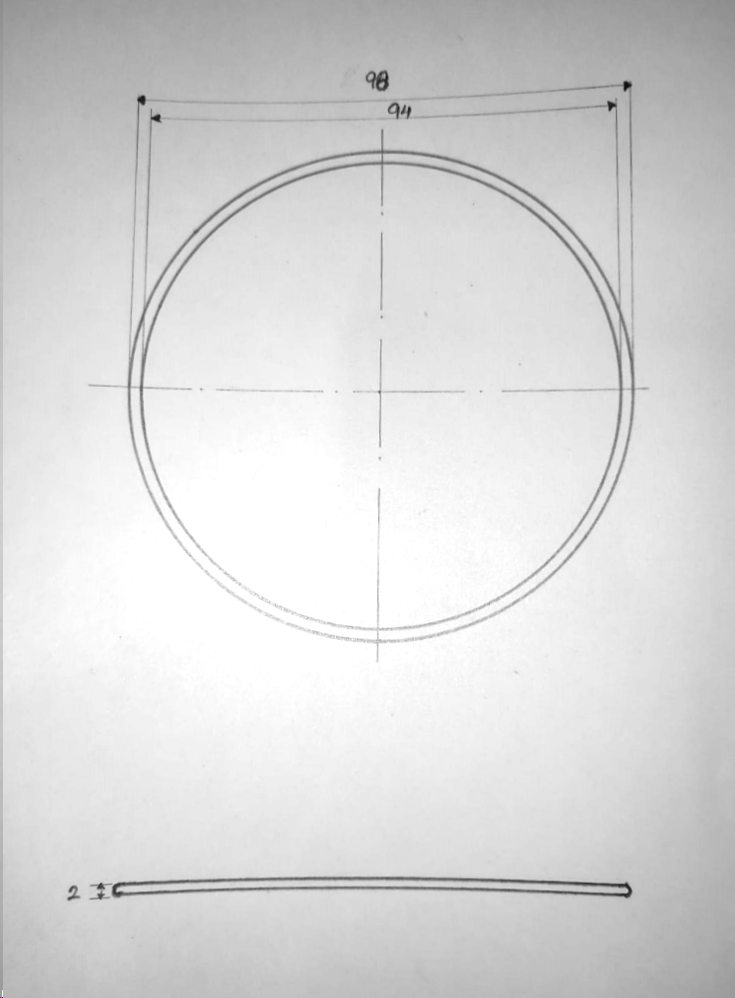
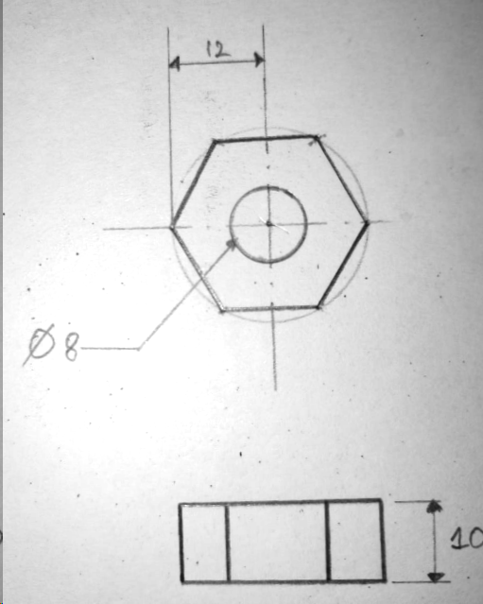
REPORT: Engineering DESIGN Internship – Phase I [7/12]
TITLE → <Convert existing Turbocharger to 3D Digital Twin>
ENGINEERING SCHEMATIC SKETCH
Gasket
Nut [Scale(2:1)]
College/ Institute/ University Name: _________________________________
Professor: _________________________________________
College/ Institute/ University Name – Dayananda Sagar College Of Engineering

Slide 8
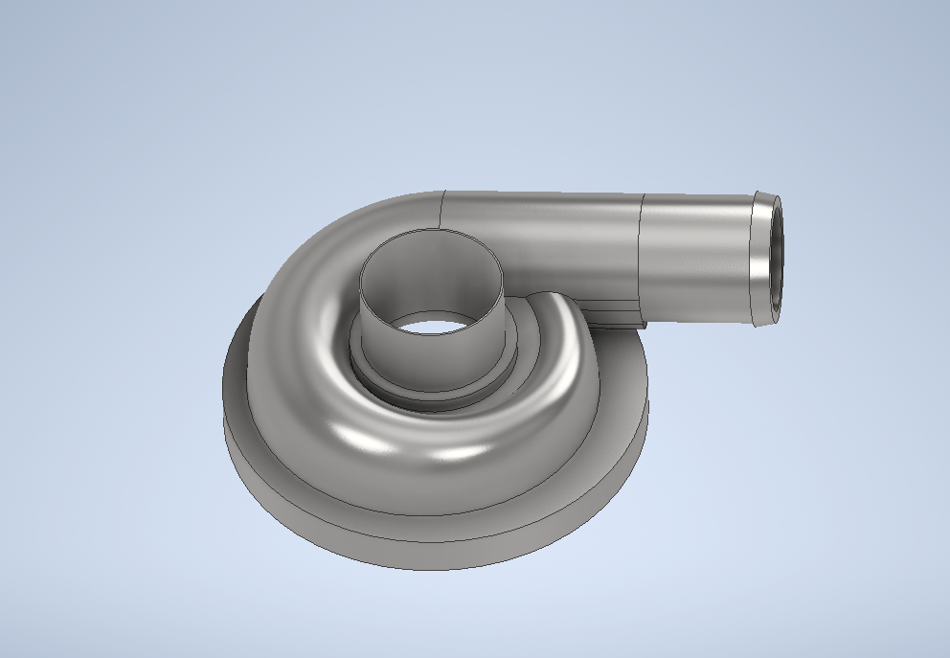
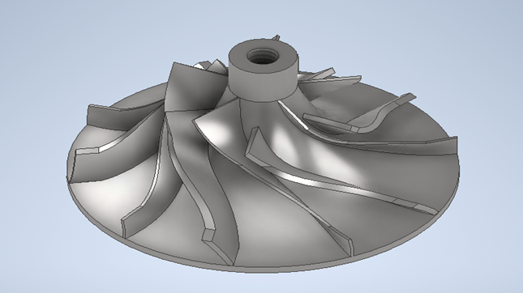
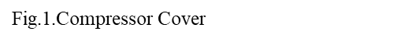
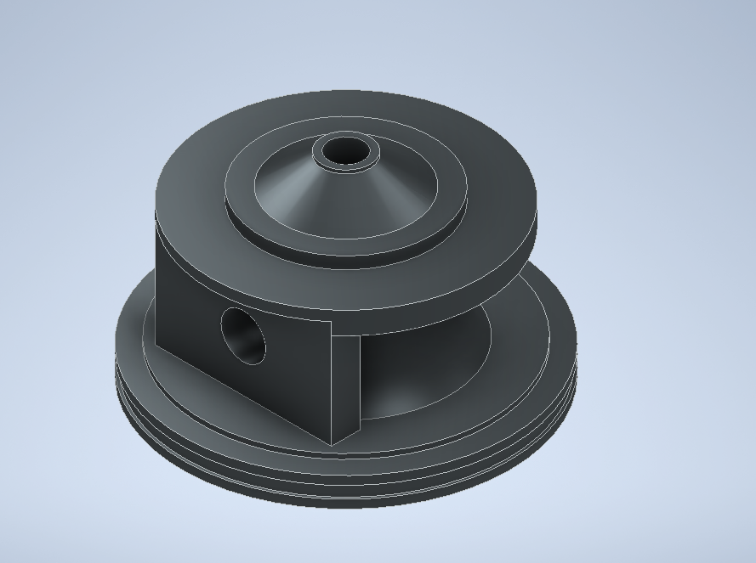
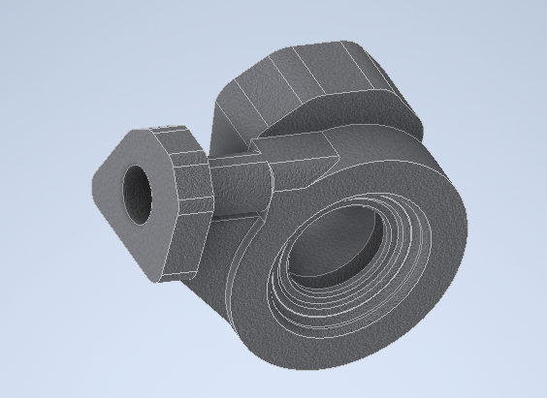
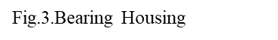
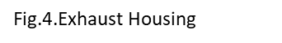
REPORT: Engineering DESIGN Internship – Phase I [8/12]
TITLE → <Convert existing Turbocharger to 3D Digital Twin>
3D MODEL
Fig.2.Compressor Wheel
College/ Institute/ University Name: _________________________________
Professor: _________________________________________
College/ Institute/ University Name – Dayananda Sagar College Of Engineering

Slide 9
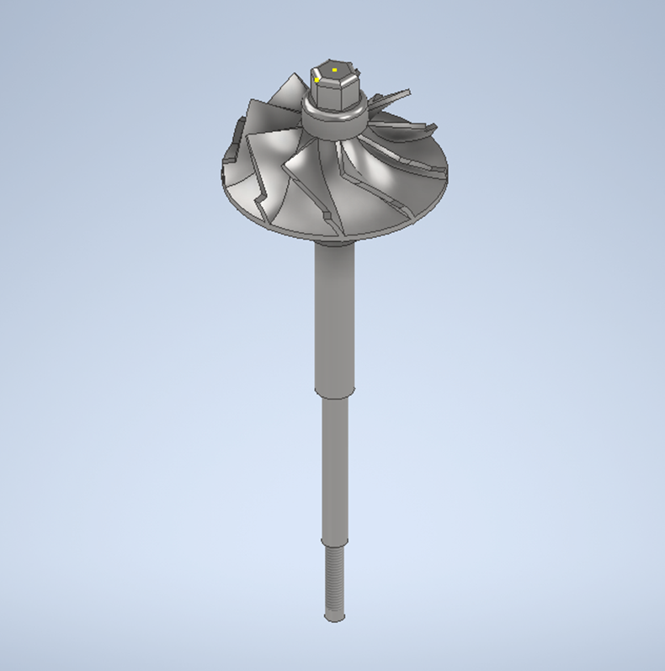
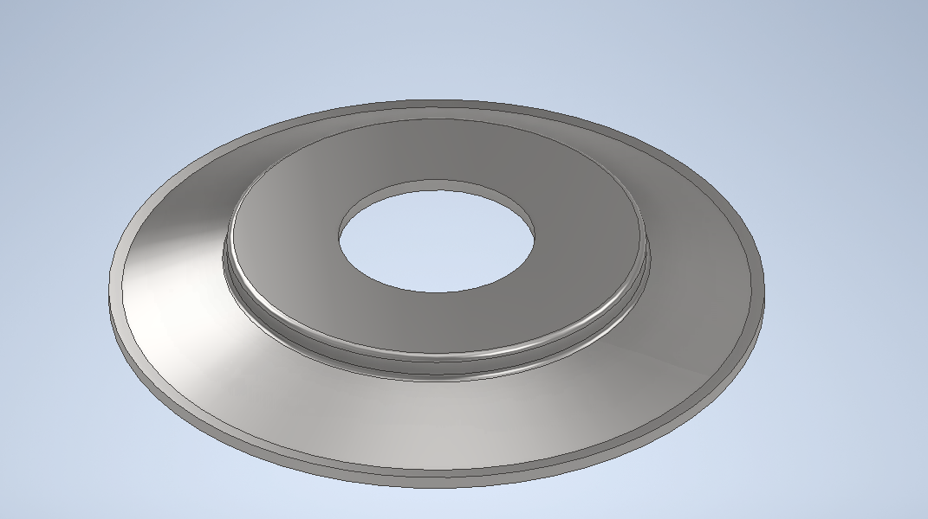
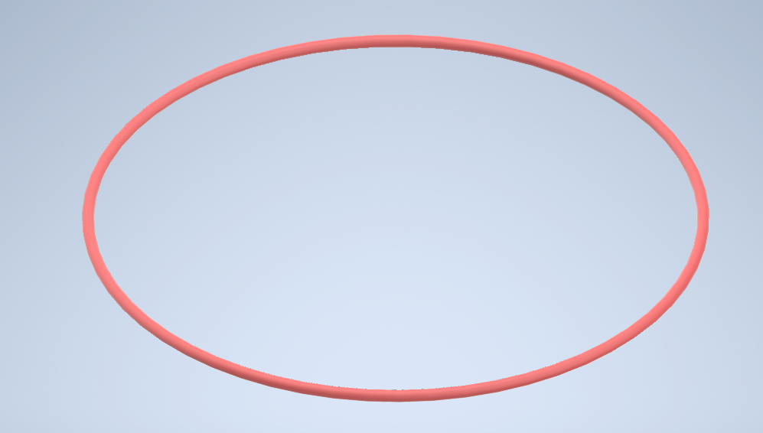
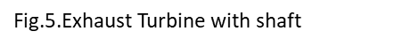
REPORT: Engineering DESIGN Internship – Phase I [9/12]
TITLE → <Convert existing Turbocharger to 3D Digital Twin>
3D MODEL
Fig.6.Gasket
College/ Institute/ University Name: _________________________________
Professor: _________________________________________
Fig.7.Gasket
College/ Institute/ University Name – Dayananda Sagar College Of Engineering

Slide 10
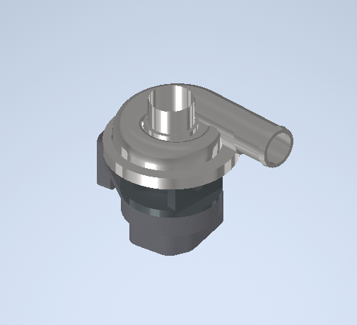
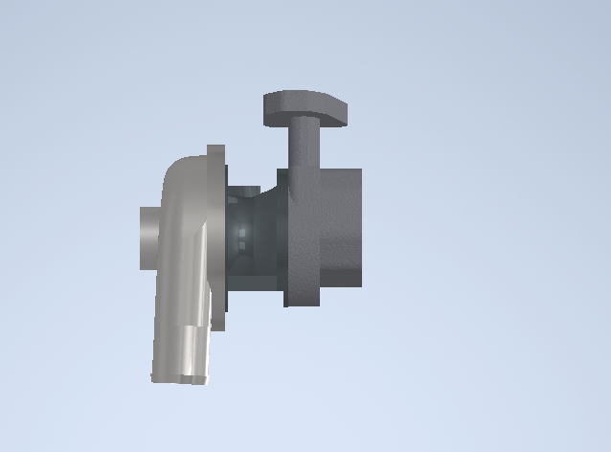
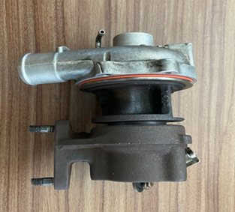
REPORT: Engineering DESIGN Internship – Phase I [10/12]
TITLE → <Convert existing Turbocharger to 3D Digital Twin>
Assembly
Physical Model
3D Assembly Model
College/ Institute/ University Name: _________________________________
Professor: _________________________________________
College/ Institute/ University Name – Dayananda Sagar College Of Engineering

Slide 11
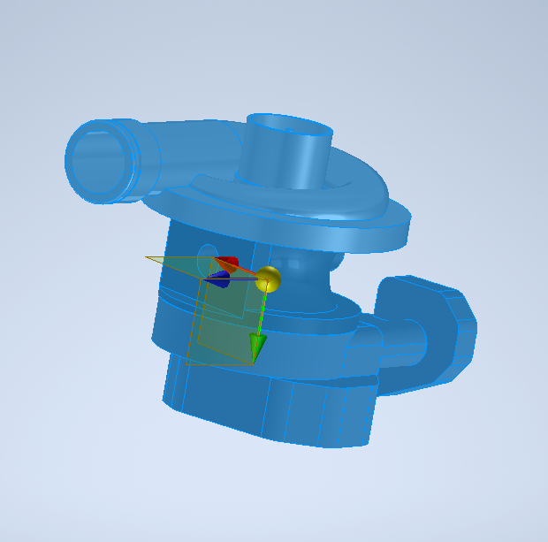
REPORT: Engineering DESIGN Internship – Phase I [11/12]
TITLE → <Convert existing Turbocharger to 3D Digital Twin>
Locating Centre Of Gravity of 3D model
College/ Institute/ University Name: _________________________________
Professor: _________________________________________
College/ Institute/ University Name – Dayananda Sagar College Of Engineering

Slide 12
REPORT: Engineering DESIGN Internship – Phase I [12/12]
TITLE → <Convert existing Turbocharger to 3D Digital Twin>
Result and Conclusion
The components and its working have been studied with its assembly.
3D digital twin model is made by extracting dimensions.
Engineering Drawing and the concept of reverse engineering has been implemented.
College/ Institute/ University Name: _________________________________
Professor: _________________________________________
College/ Institute/ University Name – Dayananda Sagar College Of Engineering

